Slide 1

High-Temperature Self-Healing Geothermal Cement Composites
Tatiana Pyatina and Toshifumi Sugama
Brookhaven National Laboratory
Work performed under DOE EERE Geothermal Technologies Program
Notes:
Overview of the project was presented at the SPE/GRC workshop

Slide 2
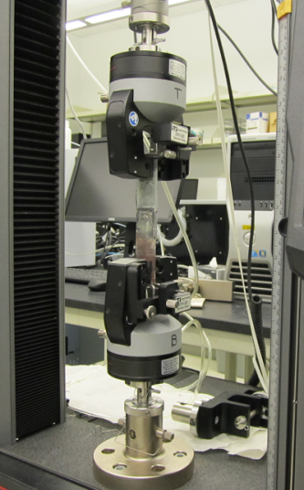
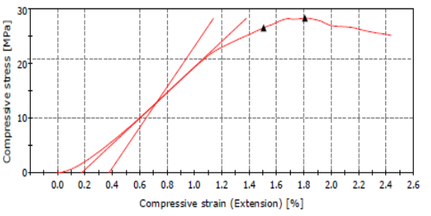
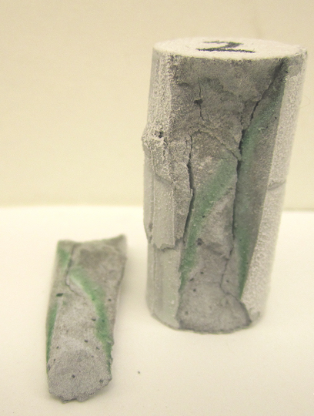
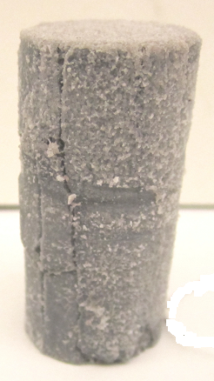

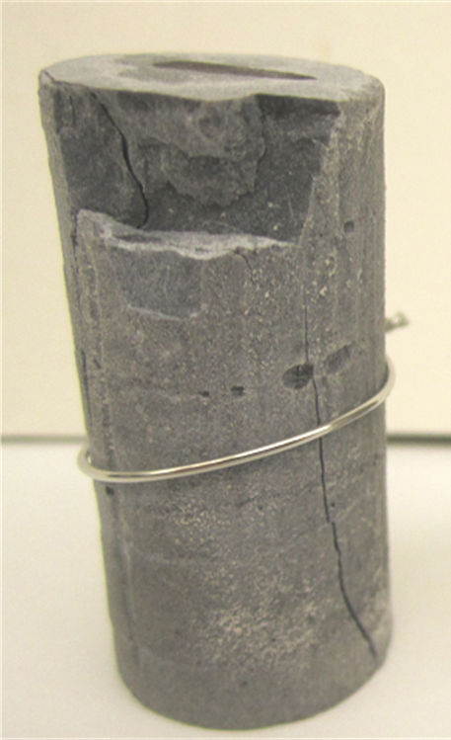
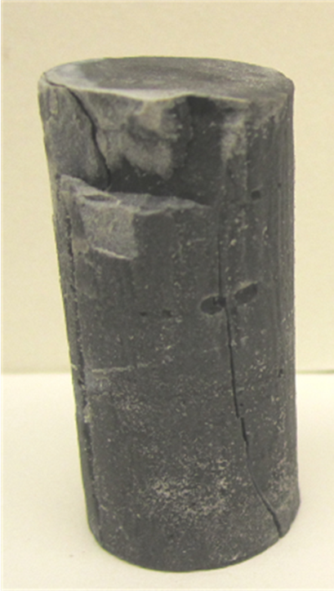
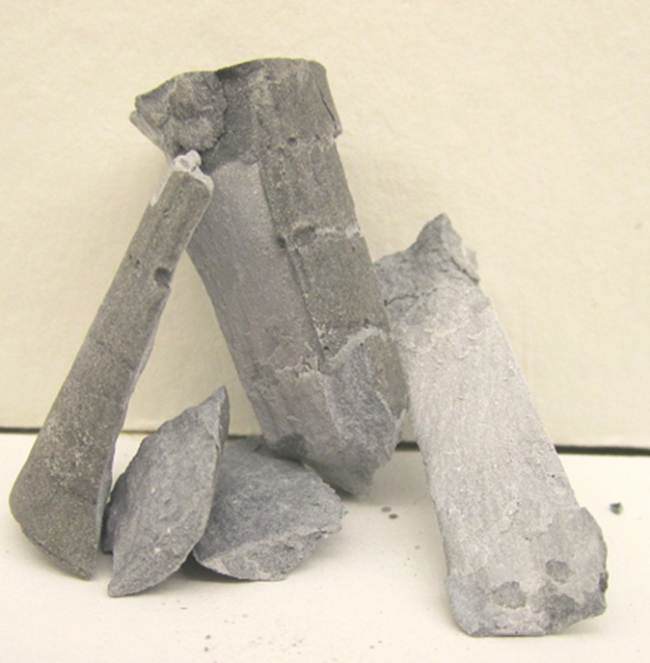
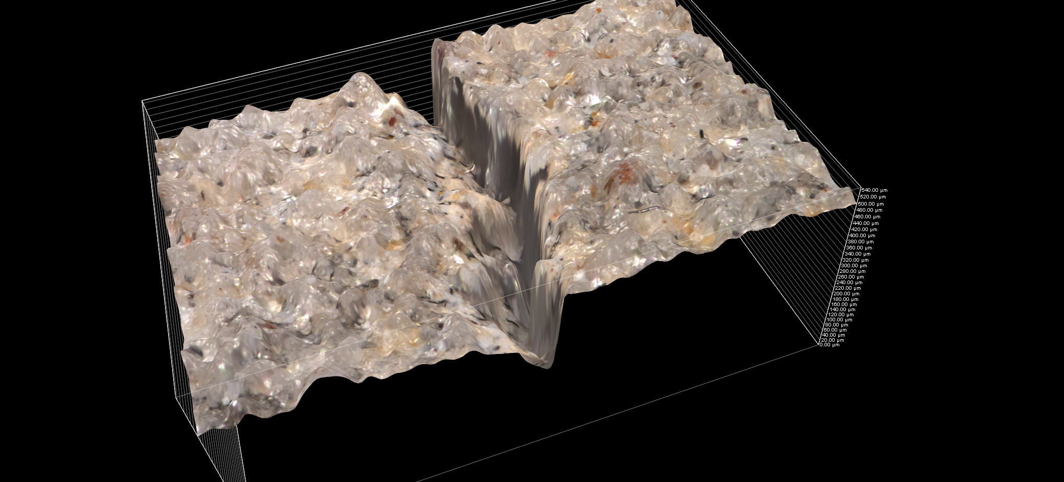
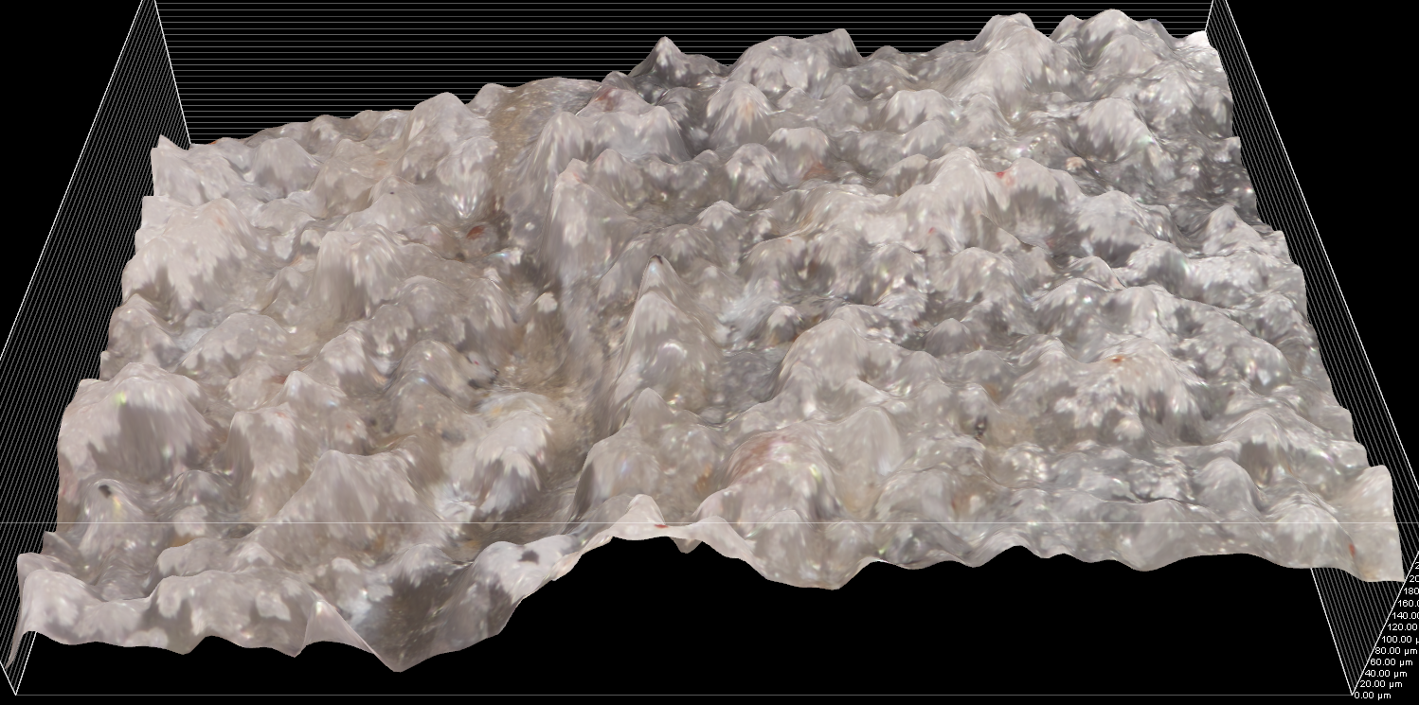
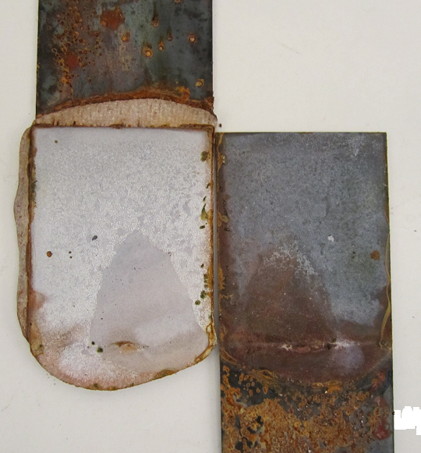
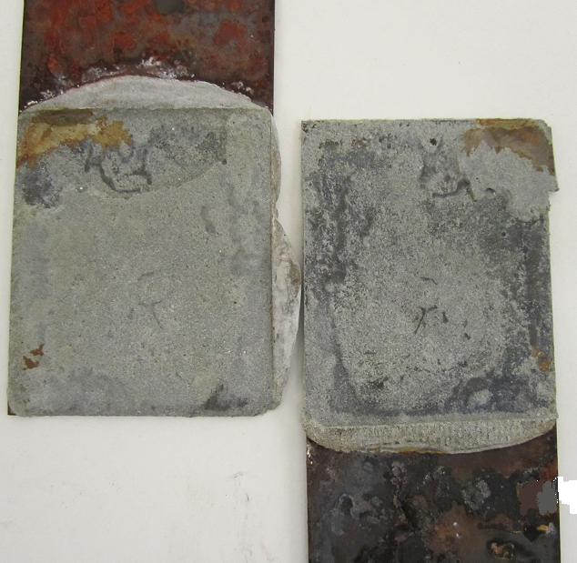
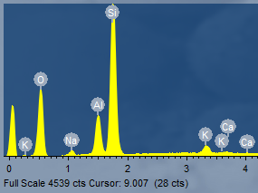
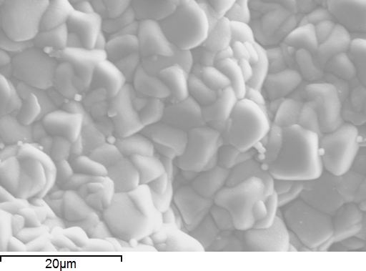
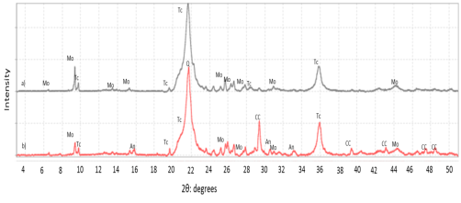
Objectives and approach
High temperatures and aggressive environments
(at up to 300ºC): self-healing requirements
Approach and test methods
Controlled damage
Strength recovery
Fractures and cracks sealing
Compressive and bond strengths
before and after the damage
Bonding recovery
Good
Optical microscope for sealing, analytical technics
for phase identification
Bad
Notes:
For a sample to be considered as self-healed strength-recovery, cracks sealing and bonding recovery are required.
To test for the self-healing of various cement composites the samples were subjected to compression damage, the broken off pieces were attached with metal wires to imitate wellbores confined environments and the samples were exposed to simulated field conditions (water, alkali carbonate or saturated geothermal brine at 300ºC). After a 5-day exposure the samples were taken out of the autoclaves, the wire removed and the compressive strength tests repeated. The bond strength was determined in lap-shear bond tests where two metal plates were cured with a thin (~2 mm) cement layer between them and the bond strength was determined as shown in the photograph by pulling on the ends of the metal pieces. The bad bond strength is shown by the adhesive failure mode, where cement is completely debonds from the metal plate during the test. The good bonding (on the right) shows cohesive cement failure during the test when the rapture of the sample happens in cement matrix and not at the interface. In post-test analyses samples compositions were identified using various analytical technics such as XRD, SEM-EDX, FT-IR, TGA and optical microscope for cracks’ sealing effect.

Slide 3
Self-healing cementitious materials
Cementitious systems
Cement binders
Calcium aluminate cement (CAC)
Ordinary Portland cement (OPC)
Pozzolan
Ferrierite (Ferr, zeolite 2)
Fly ash F (FAF) and C (FAC)
Natural
Metakaoline
Ground granulated blast furnace slag (GBFS)
Industrial by-products
Zeolite
Clinoptilolite (Clin, zeolite 1)
Clays
Bentonite
Montomorillonite
Additives
E-type Micro Glass Fiber (MGF)
Retarder
Silica
Alkali or phosphate activator
Notes:
Cementitious system considered in this project included in their compositions cement binders, pozzolanic component (natural or industrial byproducts) and additives including activators of pozzolanic blend component, set retarders, and healing aids such as E-type Micro Glass Fibers.
The pozzolans were considered as healing aids because of their slow reaction, possible long-term presence of non-reacted particles that react when exposed to environments through cracks

Slide 4
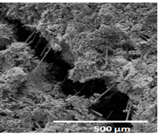
Matrix strength recovery (5 days of healing):
A+>100%; A 80-99%; B 60-79%; C<60% (10% CMF in all formulations)
Cement system | Curing Environment (270ºC and 350ºC)
 | Water | Alkali Carbonate | Hypersaline brine | Thermal shock (350ºC-25ºC)
Class G/SiO₂ | C | B | B | A
CAC (#80)/FAF* | A | A | A | A+
CAC(#80)/Zeolite 1 | A | A | A+ | A+
Class G/SiO₂/Zeolite 1 | C | A | C | N/A
OPC/Zeolite 2/SiO₂** | A+ | A | C | A+
CAP/FAF | C | C | A | A+
GBFS/FAC | B | B | B | A
GBFS/FAC/Zeolite 1 | A | A | A | A
FAC/FAF | C | B | C | A
* - Thermal Shock Resistant Cement (TSRC)
** - FlexCem
Notes:
All the cement composites were modified with carbon microfibers (CMF) for controlled crack development. The photograph shows the CMF bridging the crack and preventing its propagation.
The two best performing composites are calcium-aluminate (#80) cement blend with fly ash F, activated with sodium-meta-silicate activator and calcium aluminate cement (#80) blended with zeolite clinoptilolite and sodium-meta-silicate activator. Both formulations showed more than 80% strength recovery under all tested environments. However, the second one had a low initial compressive strength (~500 psi).

Slide 5
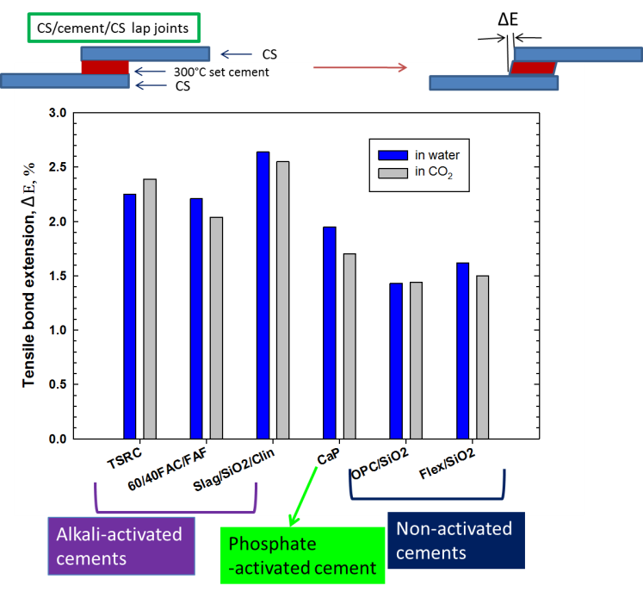

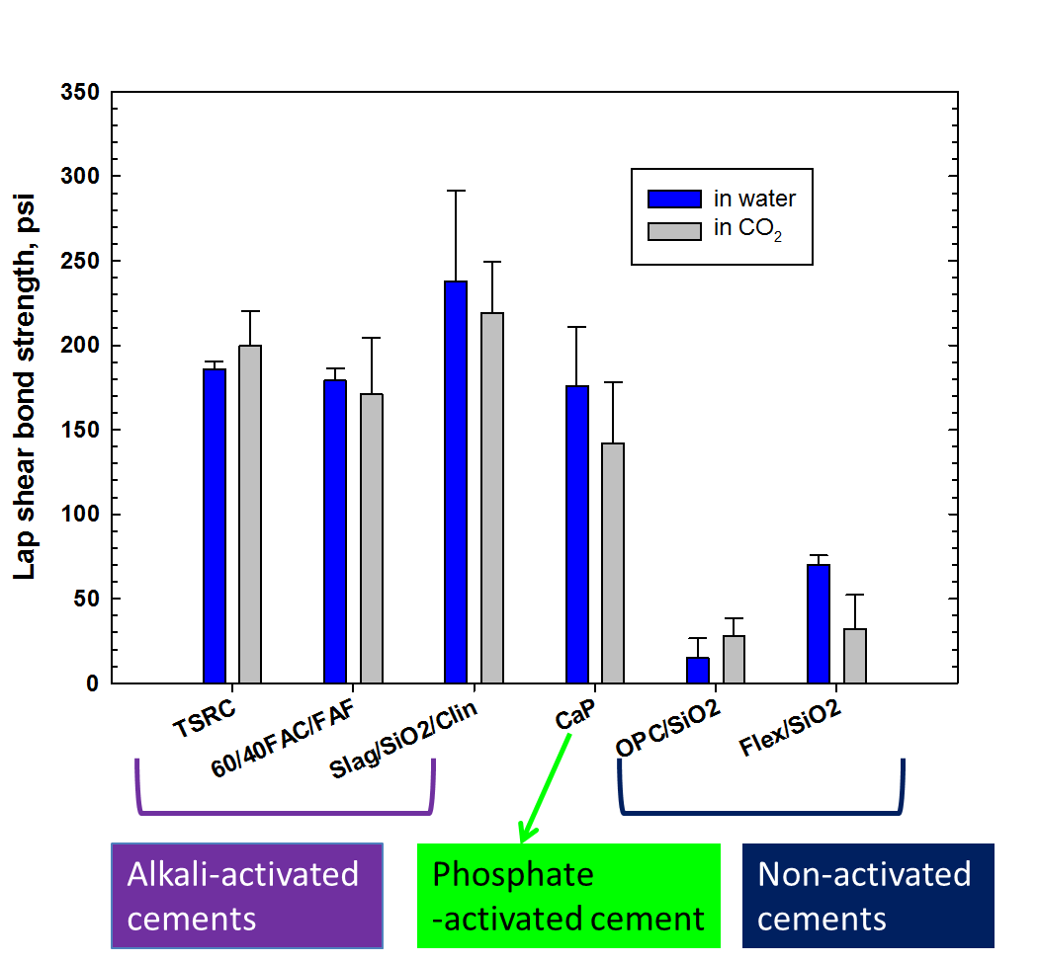
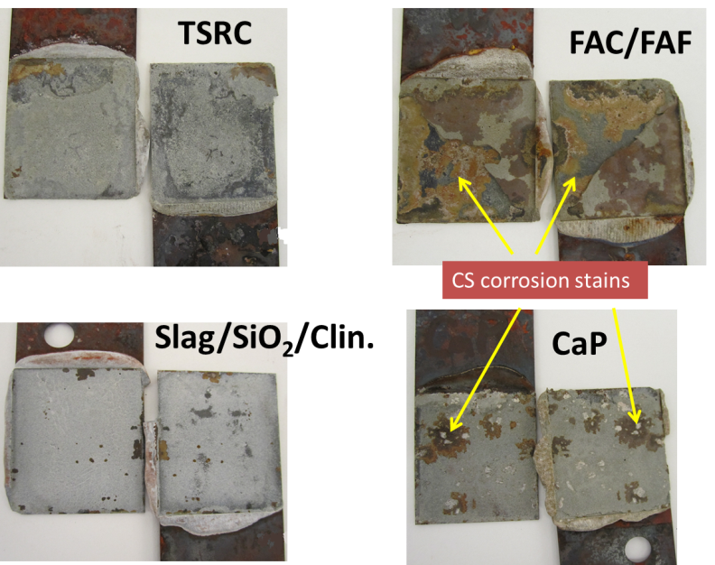
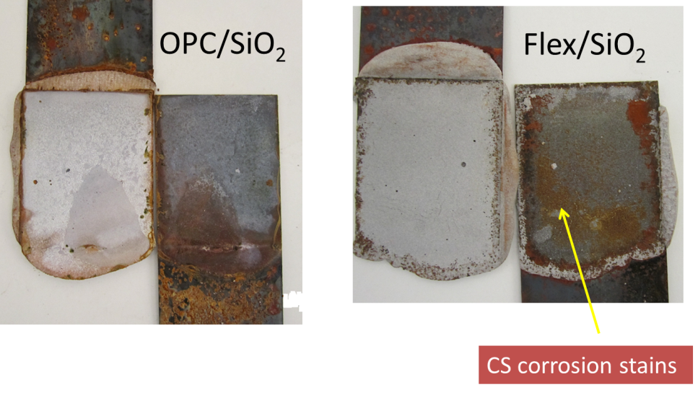
Lap shear bond testing
Lap shear bond strength (left) and tensile bond extension (right) for six cements
adhering to CS after exposure for 1 day to 300°C water or alkali carbonate environments.
Visual observation to identify the bond failure modes and CS’s corrosions for samples after exposure in water:
Cohesive and mixed failures (left) and adhesive failure (right).
Notes:
Lap-shear bond strength and tensile bond extension measurements as well as bond failure mode identification at CS/cement/CS joints.
Emphasis was on investigating the adhesive behaviors of various candidate self-healing cement systems to carbon steel (CS) surfaces in 300°C-water and -alkali carbonate environments. The approach to obtain this information involved the measurement of interfacial bond-strength and –extension (top two figures). Bond extension can be interpreted as bond toughness. The integration of all data obtained was directly correlated with the identification of three-different bond failure modes, 1) cohesive failure in cement layer, 2) adhesive failure at interfaces between cement and CS, and 3) 1) and 2) mixed failure. The most ideal failure is cohesive failure, meaning that the bond strength of cement to CS is higher than that of cement itself. Figure 2 compares the lap shear bond-strength and –extension of six different cement systems
adhering to CS surfaces. Six cements can be classified in three groups, 1) alkali-activated cement, 2) phosphate-activated cement, and 3) non-activated cement. As a result, alkali- and phosphate-activated cements displayed a far greater bonding strength than that of non-activated calcium-silicate cements, which were prepared by using the conventional Ordinary Portland cement (OPC) as control. The data also revealed that there was no significant difference in bond-strength and –extension between samples cured in water and CO₂ environments. All activated cements significantly exceeded the material criterion that was required to possess bond-strength and/or -toughness >30% higher than that of the conventional well cement like OPC/SiO₂.
The information described above was directly correlated with the identification of interfacial bond failure modes (Figure 3). As seen, all activated cements along with a better bond-strength and –toughness offered the ideal cohesive or mixed failure modes. In contrast, the OPC-based cements, OPC/SiO₂ and Flex/SiO₂, exhibiting a poor bonding behavior displaying the adhesive failure. Additionally, one important concern was the corrosion of CS by cement or its additives. Thus, attention was also paid to CS’s corrosion for post-bond test samples. Two cement systems, TSRC and slag/SiO₂/Clin., showed minimal CS’s corrosion. Similar results were obtained from the samples after exposure to alkali carbonate environment (not shown).

Slide 6
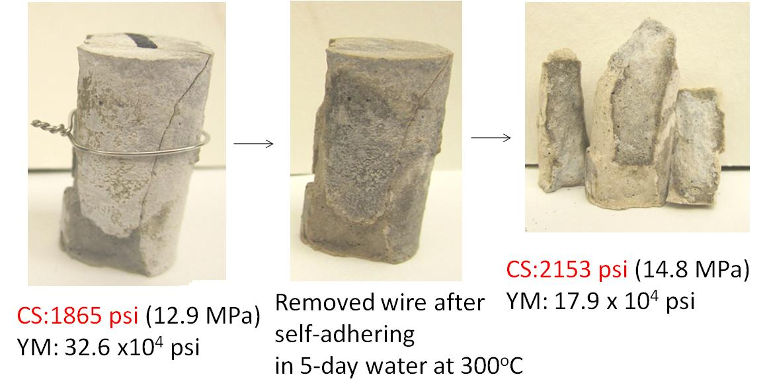
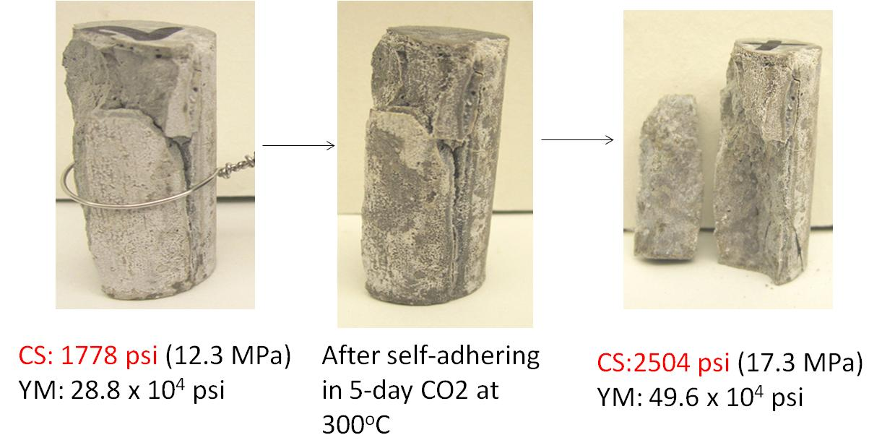
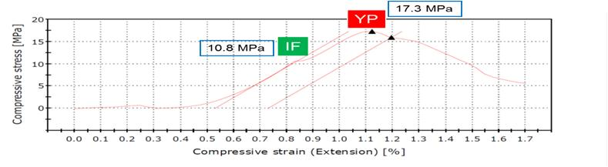
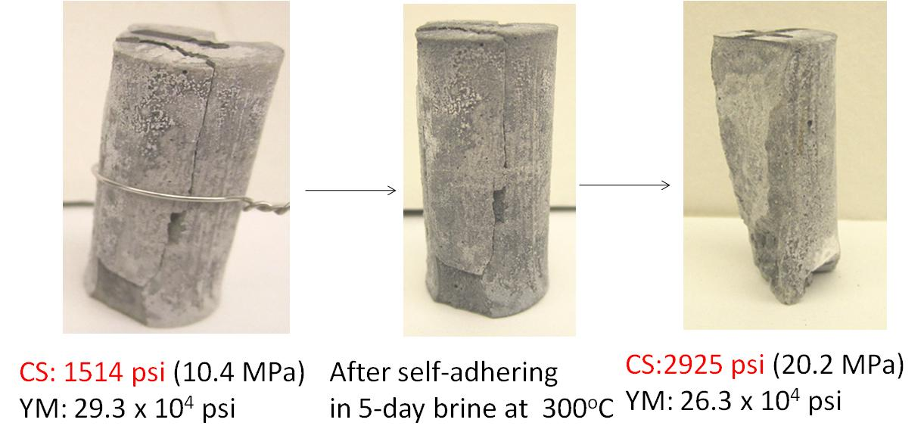
Self-adhering behavior of TSRC with micro-glass fiber (MGF) at 300ºC.
water
CO₂
brine
Notes:
Micro-glass fibers (MGF) were tested as healing aids with cement formulations that underwent cohesive failure indicating that under stress conditions the cement matrix will fail and will need to heal. The data showed outstanding strength recoveries of damaged cement samples of calcium aluminate cement/fly ash F/ sodium metasilicate activator (Thermal Shock Resistant Cement) modified with MGF. The strength of the healed samples was higher than that of the original, likely due to the continuous curing of fly ash and reactions of MGF. The point of initial failure (IF) on the stress-strain curve is believed to indicate the strength of the recovered bond (re-bonding of the broken piece).

Slide 7
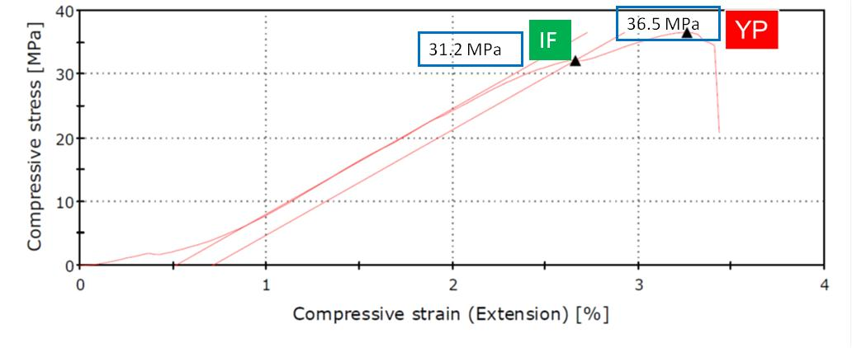
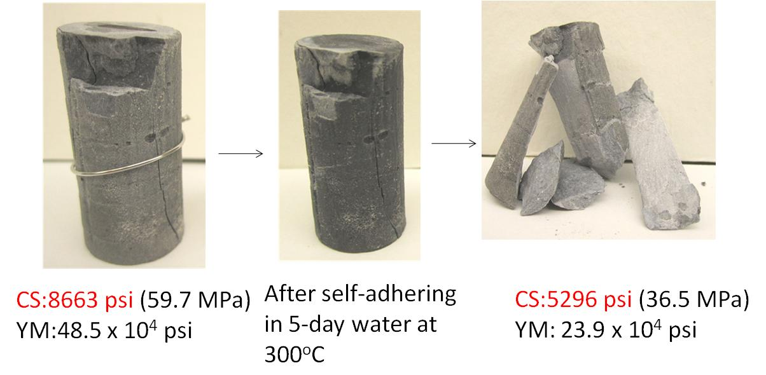
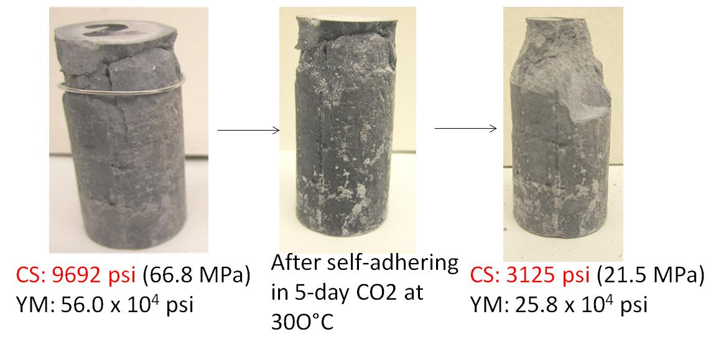
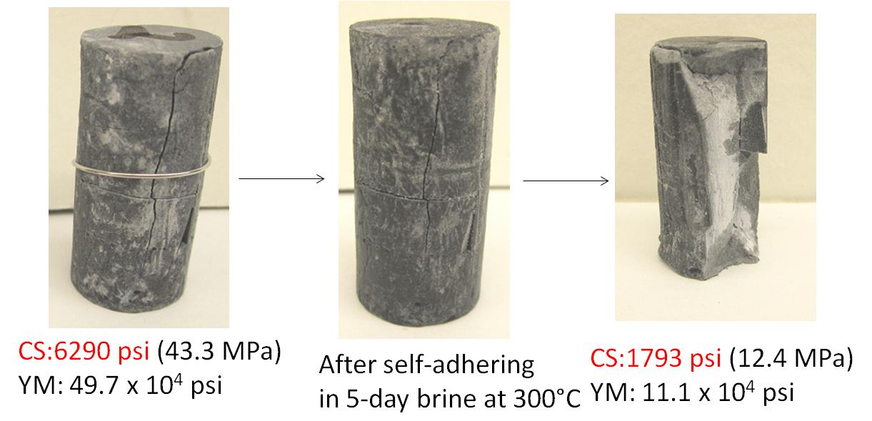
Self-adhering behaviors of very high strength Slag/SiO₂ cement with MGF at 300ºC
water
CO₂
brine
Notes:
For strong-brittle formulations the strength recoveries were not as good as for tougher TSRC. The shape of the stress-strain curve demonstrates the brittle cement failure.

Slide 8
Universal healing aid – micro glass fibers (MGF)
Matrix strength recovery: A+>100%; A 80-99%; B 60-79%; C<60%
Cement system | Curing Environment (300ºC)
 | Water | Alkali Carbonate | Hypersaline brine
Formulations with Micro Glass Fibers (MGF)
Class G/SiO₂/MGF | A | A | A
CAC (#80)/FAF/MGF | A+ | A+ | A+
CAC(Fondu)/FAF/MGF | A+ | A+ | A+
CaP/FAF** | C | B | A
FAC/FAF/MGF | C | C | B
GBFS/SiO₂/MGF | A | A+ | B
Lap Shear Bond strength/Bond extension, psi/%
Class G/SiO₂/MGF | 52/1.43 | 30/1.3 | 74/1.75
CAC (#80)/FAF/MGF | 237/2.81 | 347/4.47 | 260/3.51
CAC(Fondu)/FAF/MGF* | 4/1.22 | 35/1.44 | 6/0.98
CaP/FAF | 196/2.37 | 125/1.49 | 106/1.5
FAC/FAF/MGF | 189/2.17 | 228/2.64 | 15/1.28
GBFS/SiO₂/MGF | 345/4.22 | 254/3.33 | 98/1.35
*- slow-set system; ** - brittle cement
Notes:
The table summarizes strength recoveries for the composites modified with the GMF. The GMF further improved self-healing performance of TSRC, bringing the strength recoveries above 100%. The performance improvement was not as significant for brittle calcium-phosphate cement. TSRC also demonstrated the best bond strength to carbon steel. Similar formulation where calcium-aluminate cement #80 was replaced by more economical cement Fondu showed very low bond strength likely due to the slow set of the cement.

Slide 9
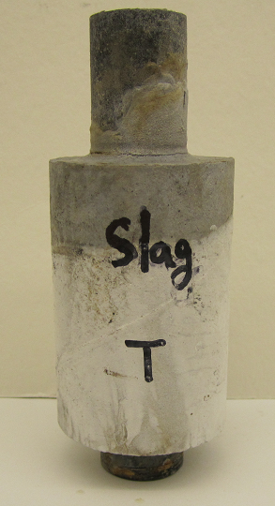
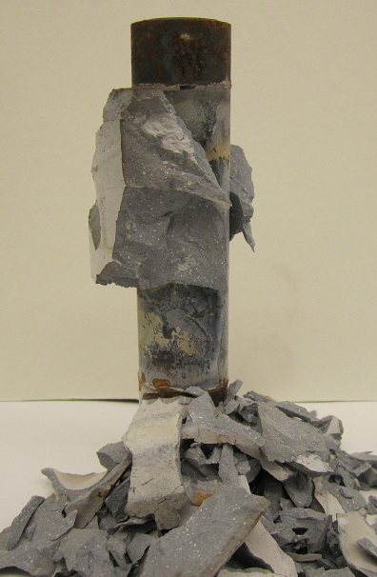
Brittle cement in thermal shock tests - after heating to 350ºC
Before test
After heating to 350ºC
GBFS/SiO₂/MGF
Notes:
For slag/SiO2/5% MGF cement, before (right) and after heating at 350°C (left). The thermal-shock performance of brittle cement is important to test. In the tests the samples are heated to 350oC for 24 hours followed by a 25oC water passing through the tube. The metal shrinks and cement debonds from the pipe. The brittle cement may undergo significant damage like in the case of ground granulated blast furnace slag-based formulation, which decomposed completely during the first heating period.

Slide 10
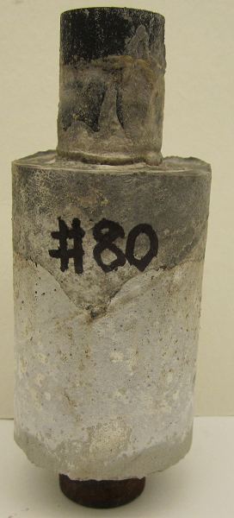
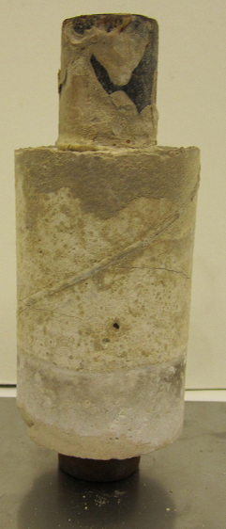
Tough cement in thermal shock tests - 6 cycles of heating to 350ºC – 25ºC water cooling
Before test
After test
Developed hair cracks
Thermal shock resistant cement
(CAC(#80)/FAF/SMS) with GMF
Notes:
For TSRC cement, before (left) and after 6 cycles TS test. Excellent TSRC performance.

Slide 11
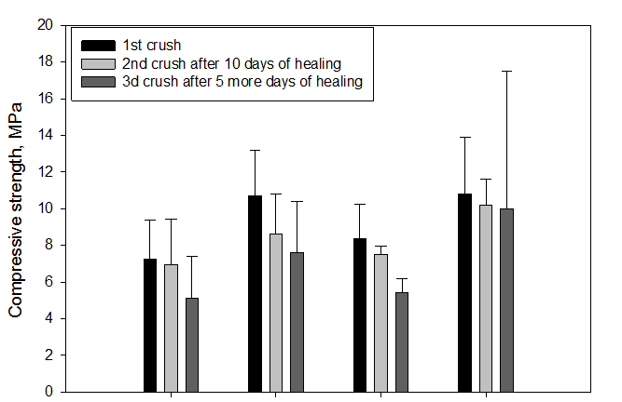
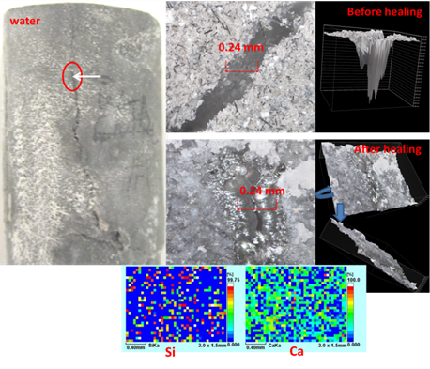
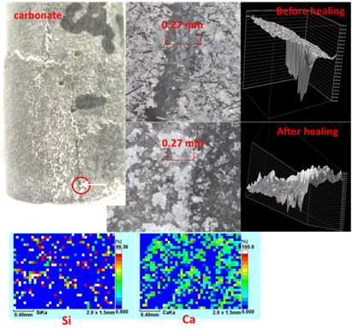
Effect of retarder on strength recovery
and cracks sealing – 1% Tartaric Acid
TA
TA
No TA
No TA
Before healing
After healing
Water
Carbonate
Before healing
After healing
Si
Ca
Water
Carbonate
Si
Ca
Notes:
Tartaric acid retarder, identified as the most effective for TSRC placement, acted as a retarder aid both increasing strength recovery and improving cracks sealing of TSRC samples.

Slide 12
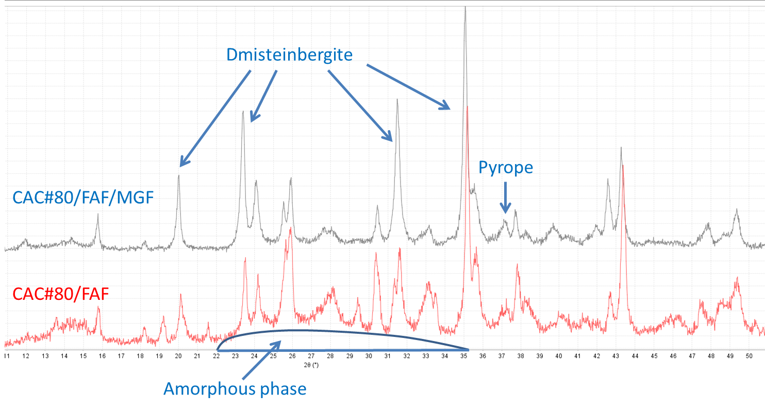
Phases participating in self-healing
Crystalline phases:
  Matrix strength recovery – Calcium aluminum silicates (feldspars); sodium aluminum silicates (zeolites); calcium silicate (TA); carbonated calcium-aluminum-silicate (in carbonate environment); magnesium (calcium) silicates (in brine)
  Cracks – Zeolites; calcium-aluminum silicates (feldspar and Ca-containing mica type)
Amorphous phases:
  Sodium(calcium)-aluminum-silicate hydrate
Effect of GMF:
  Increased crystallinity at short curing times; Mg-containing silicates in all environments – improved strength recovery (fast MGF reaction)
Water

Slide 13
Summary:
Cementitious materials can be formulated to have self-healing properties allowing strength recovery and cracks sealing at temperatures up to 300ºC (inorganic matrix)
CAC/FAF/SMS blend (TSRC) showed the best performance among tested materials
Strength recovery and cracks sealing maybe further improved with additives such as Micro Glass Fibers and set retarder (TA)
MGF are most appropriate for formulations with high amorphous phase content
Future directions:
Self healing behavior after long-term exposure tests (steam, alkali carbonate and geothermal brine)
Phase identification of healing reaction products
Healing behavior after long term exposures to sc CO₂/brine and pH 1 H₂SO₄/brine of cement matrix and cement-casing bonding

Slide 14
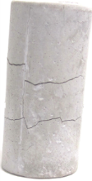
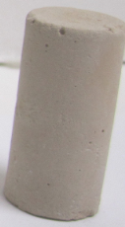
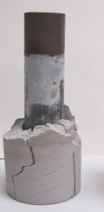
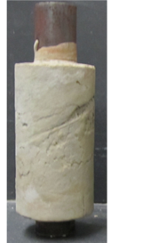
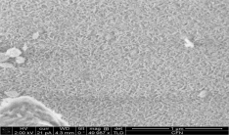
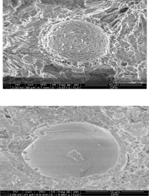

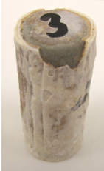
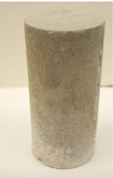
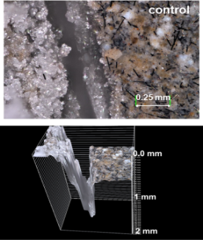
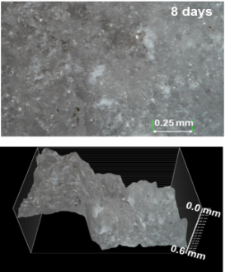
Thermal shock
Resistance and Bond Strength
CAC/FAF/SMS
Strength recovery and fractures sealing
Carbonation
resistance
Crystalline phases:
Zeolites – Sodalite
Cancrinite
Analcime
Thomsonite
Before healing
After healing
Stable Crystalline phase:
Carbonated sodalite
Sodium Cancrinite H_{0.88}Na₈Al₆(SiO₄)₆(CO₃)_{1.44}(H₂O)₂
water
1865 psi
Before CO₂
1865 psi
2150 psi
OPC/SiO₂
CAC/FAF/SMS
CO₂
After CO₂
1780 psi
2504 psi
Acid resistance
brine
Stable Crystalline phase:
Alunite
Amorphous phase:
Aluminum silicate
CAC/FAF/SMS
1510 psi
2925 psi
Before
Sealing
After
CAP
Lap Shear Bond Strength
OPC/SiO₂
OPC/SiO₂
CAC/FAF/SMS
Cements formulations
Notes:
The summary slides shows that TSRC outperforms class G/SiO2 blend in all the comparative tests.

Slide 15
Questions?

